Slide 1


Overview
of
MIMS
Overview
of
Multi-Tenant Information Management System
Confidential and Proprietary
This document should be used only to evaluate Damyant Software as a potential service provider. Any or all other usages are strictly prohibited and illegal.

Slide 2
About MIMS
MIMS stands for (Multi-Tenant Information Management System ).
MIMS is an open-source system to support integrated data management, analytic and business intelligence services for Government and Enterprise Customers.
Enhance decision making by accessing right information at the right time.
Easy-to-use interface to upload all revenue data collection at various sub-divisional level.
MIMS is a web based application.

Slide 3
Features of MIMS
Provide an easy to use information processing gateway.
Build a collaborative ecosystem to bring best industry best practices and processes.
Easy-to-use interface to upload all revenue data collection at various sub-divisional levels.
Provide automatic report generation at Corporate HQ, Circle, Division and Sub-Division levels.
Enable access to information from web or mobile apps.
Most smart feature of MIMS is, data collection can be done offline via Android Mobile app.
Improved Operational Effectiveness by reducing redundancy, inefficiency and inaccuracy of data management.
Increased Operational Safety.

Slide 4
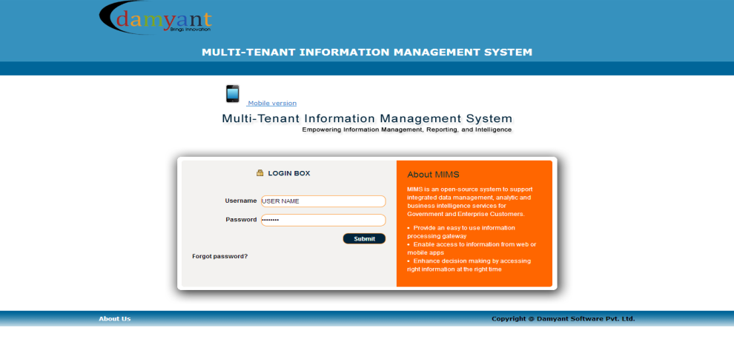
Login to MIMS
What should a user require to use the application?
  A user must have Authenticated Username and Password to use the given application Cloud Computing.
  The Username and Password will be provided by the Admin.
How to get started with the application?
  Open any prescribed browser and enter the URL: http://173.45.100.234:6080/osrs/ in the address bar of the opened browser and press 'Enter' key on the Keyboard.
  After pressing 'Enter' the 'Login' page will open as given below.

Slide 5
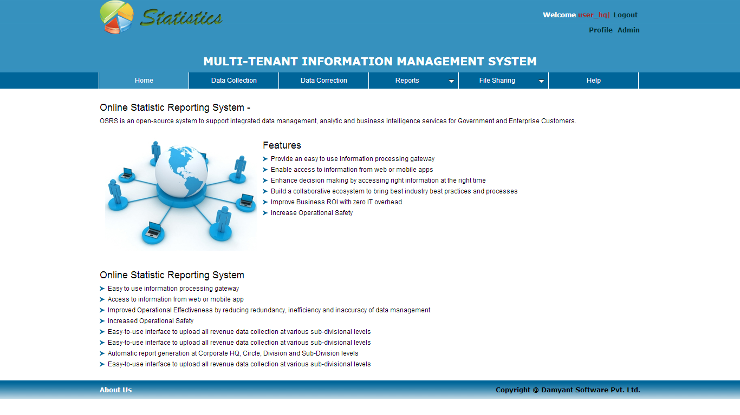
Home of MIMS
  Enter your authenticated username and password in the text box corresponding to username and password field respectively.
  After entering the username and password click on ‘Login’ button.
  On clicking on ‘Login button’ you will enter into the system an d land to ‘Home page’ where you can see your privileges shown below.

Slide 6
Types of Users in MIMS
There are four types of users in MIMS
    User _Admin(ROLE_ADMIN)
    User _HQ(ROLE_STATE_ADMIN)
    User (ROLE_USER)
    User_Deo(ROLE_DATA_ENTRY_OPERATOR)
Each User has different rights to access the menu’s of MIMS based on their role.

Slide 7
Privileges Of Users
As discussed before a user has different rights to access the menu’s of MIMS which are :
    Data Collection
    Data Correction
    Reports
    File Sharing
Which user has rights to access which menu are discussed further.

Slide 8
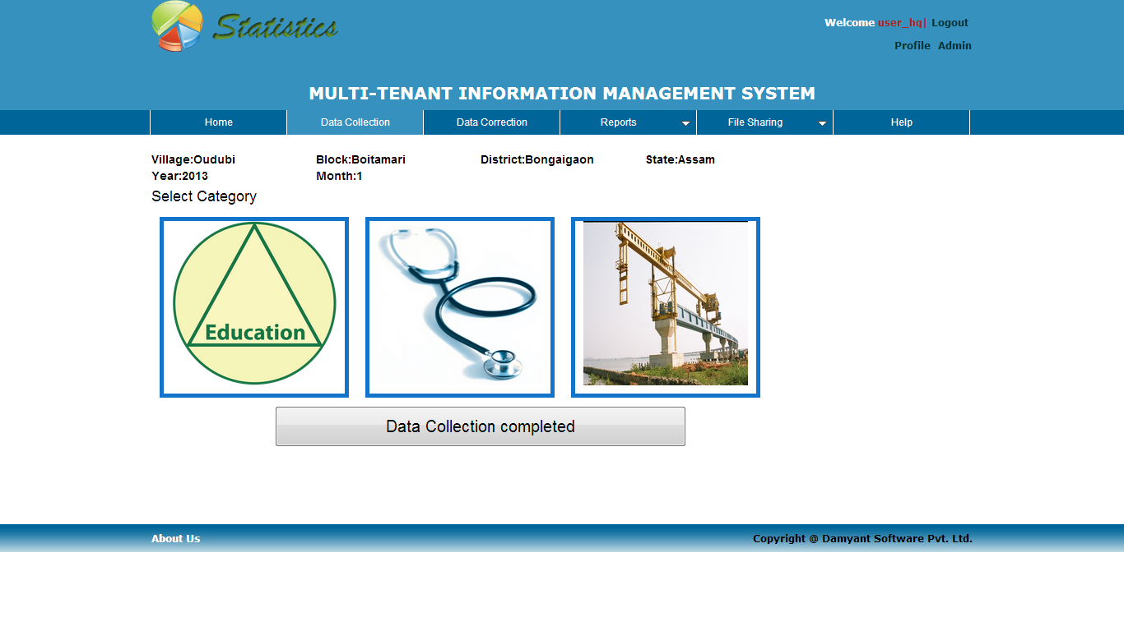
How to use MIMS Cont…
Data Collection : The Data Collection page allows Authenticated User to enter the data regarding three categories as you can see in above figure and the categories are listed below.
    Education
    Healthcare and Family Welfare
    Infrastructural facilities
Who is allowed to enter data in Data Collection page?
    Authenticated User at Admin level, User_HQ, User_deo is allowed to enter the data at the Data Collection Page. You can access the Data Collection page by clicking on the Data Collection menu link located on the main menu bar.

Slide 9
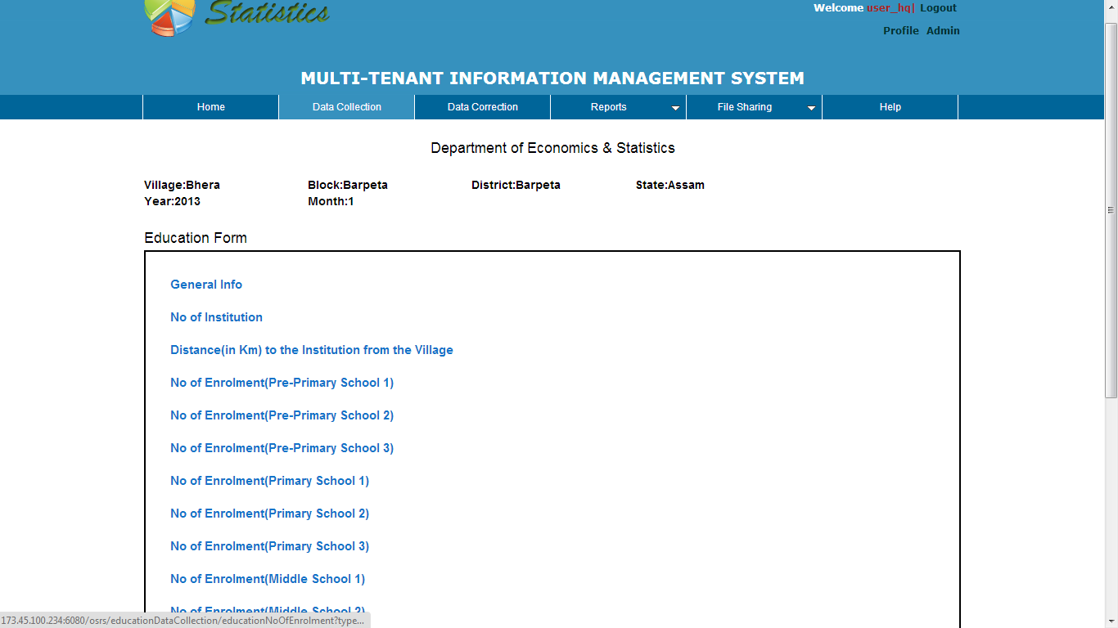
How to use MIMS Cont…
Selecting the Category : As you can see there are tree categories defined in ‘Data Collection’ page, you can select any category for which you want to enter data by just clicking on the ‘Category Icon’ and it will open a page of the selected category.
  Education Category : To enter data in 'Education' category, just click on the 'Education Icon' and it will open the 'Education Form' page from where you can enter data related to 'Education' category as you can see in below Figure.

Slide 10
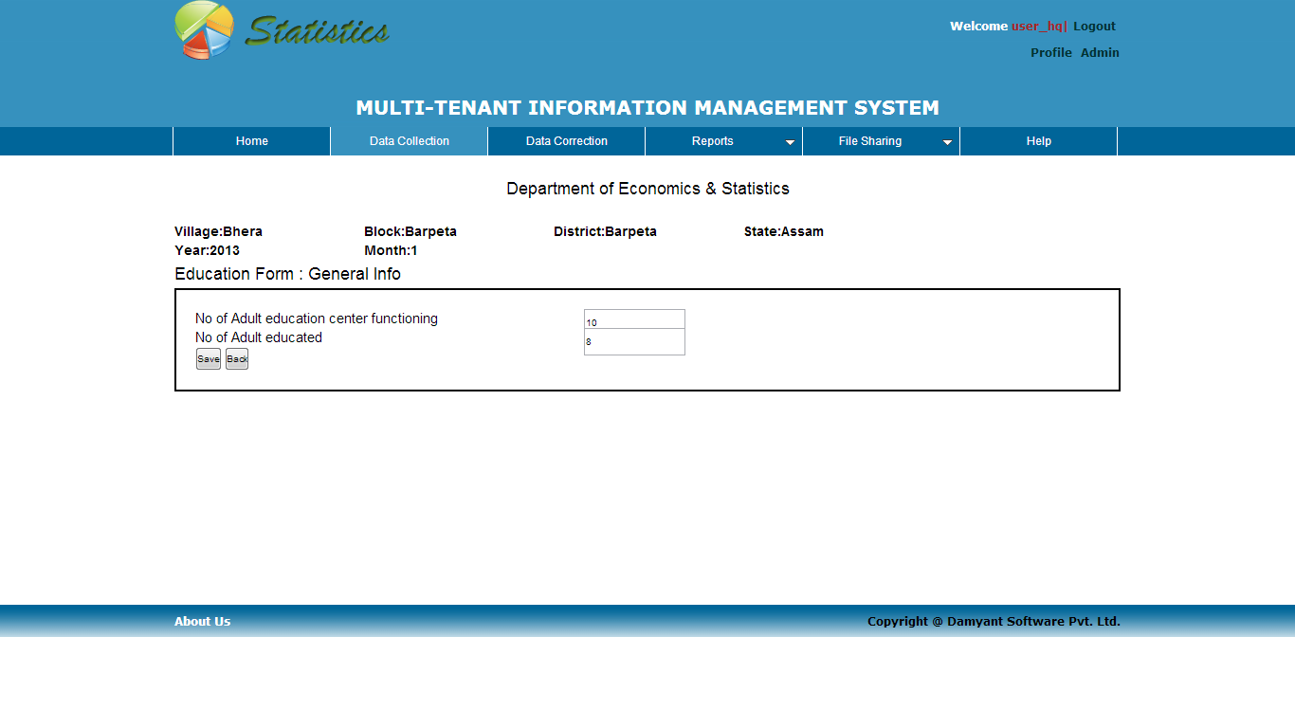
How to use MIMS Cont…
  How to enter data in ‘Data Collection ’ page for education category?
    As you click onto the Education Icon located on the 'Data Collection' page. It will open a Education form which consists of list of menus for education.
    You can click on any menu to enter data related to it. For example if you click on 'General Info menu' it will open a 'General Info' page from where you can enter data related to it as you can see in below Figure.

Slide 11
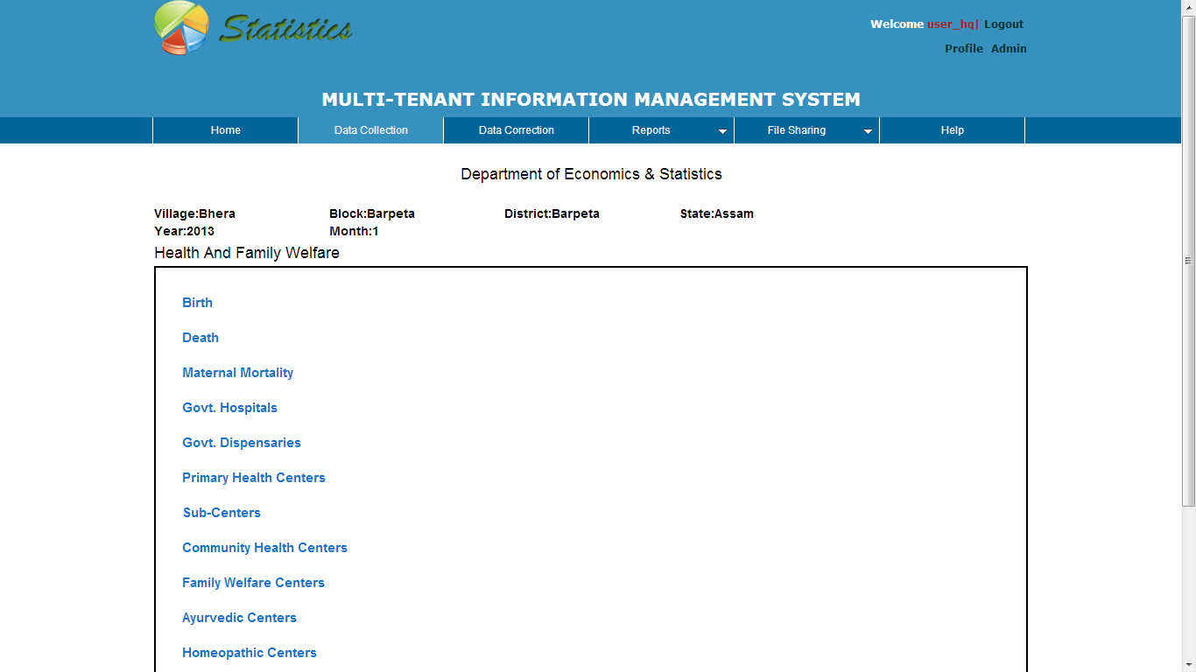
How to use MIMS Cont…
  After entering data you can save it by clicking on 'Save' button and if you don't want to save the data you can simply click on 'Back' button.
  You can follow the same steps for entering data in other menus of 'Education' category.
  Health and Family Welfare Category : To enter data in 'Health & Family Welfare' category, just click on the 'Health & Family Welfare Icon' and it will open the 'Health & Family Welfare Form' page from where you can enter data related to 'Health & Family Welfare' category as you can see in below Figure.

Slide 12
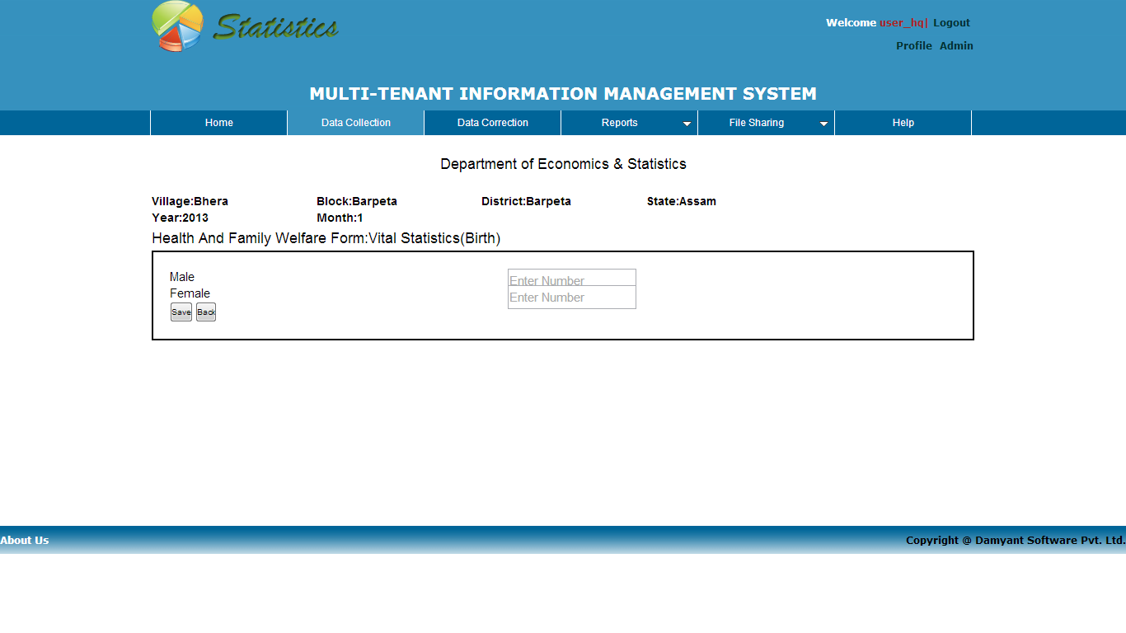
How to use MIMS Cont…
How to enter the Data in the Data Collection Page for Health & Family Welfare Category?
    As you click onto the Health & Family Welfare Icon located on the 'Data Collection' page. It will open a Health & Family Welfare form which consists of list of menus .
    You can click on any menu to enter data related to it. For example if you click on 'Birth menu' it will open a 'Birth Info' page from where you can enter data related to it as you can see in below Figure.

Slide 13
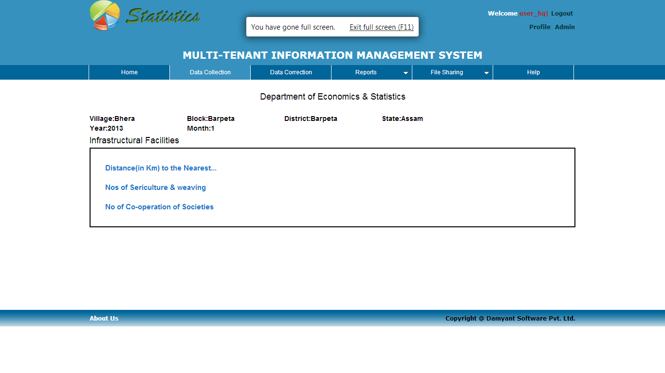
How to use MIMS Cont…
  After entering data you can save it by clicking on 'Save' button and if you don't want to save the data you can simply click on 'Back' button.
  You can follow the same steps for entering data in other menus of ' Health & Family Welfare ' category.
  Infrastructural Facilities Category : To enter data in 'Infrastructural Facilities' category, just click on the 'Infrastructural Facilities' Icon and it will open the 'Infrastructural Facilities Form' page from where you can enter data related to 'Infrastructural Facilities' category as you can see in Figure 9

Slide 14
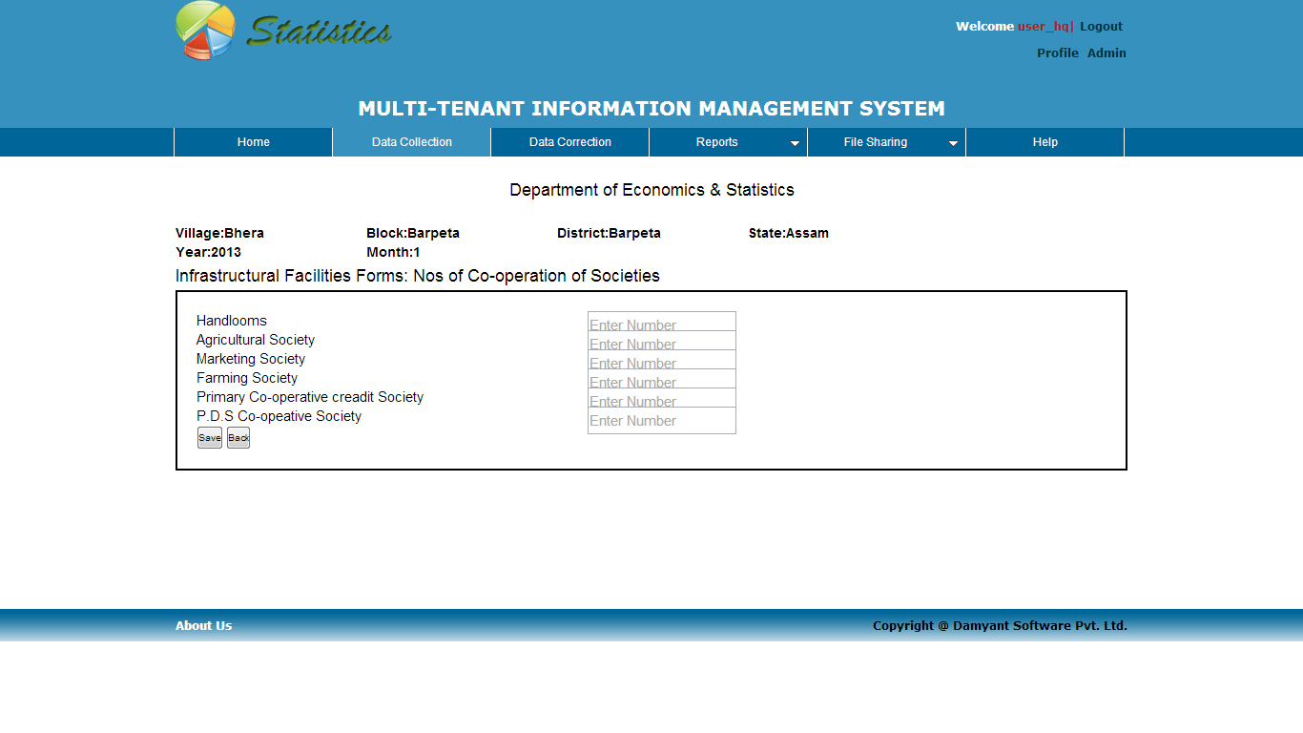
How to use MIMS Cont…
How to enter the Data in the Data Collection Page for Infrastructural Facilities Category?
    As you click onto the 'Infrastructural Facilities Icon' located on the 'Data Collection' page. It will open a Infrastructural Facilities form which consists of list of menus .
    You can click on any menu to enter data related to it. For example if you click on 'No of Co-operation of Societies' menu it will open a 'No of Co-operation of Societies' page from where you can enter data related to it as you can see in below Figure.

Slide 15
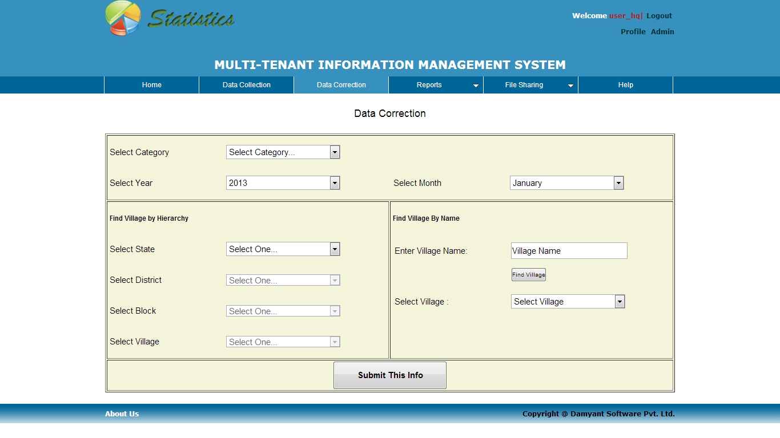
How to use MIMS Cont…
  After entering data you can save it by clicking on 'Save' button and if you don't want to save the data you can simply click on 'Back' button.
  You can follow the same steps for entering data in other menus of 'Infrastructural Facilities' category.
  Data Correction : The privilege of data Correction is assigned only to authenticated Uase_admin and User_HQ The Data Correction page allows Authenticated User to update the previous stored data.
  You can access the Data Correction page by clicking on the Data Correction menu link located on the main menu bar. It will open the Data Correction page as you can see in below Figure.

Slide 16
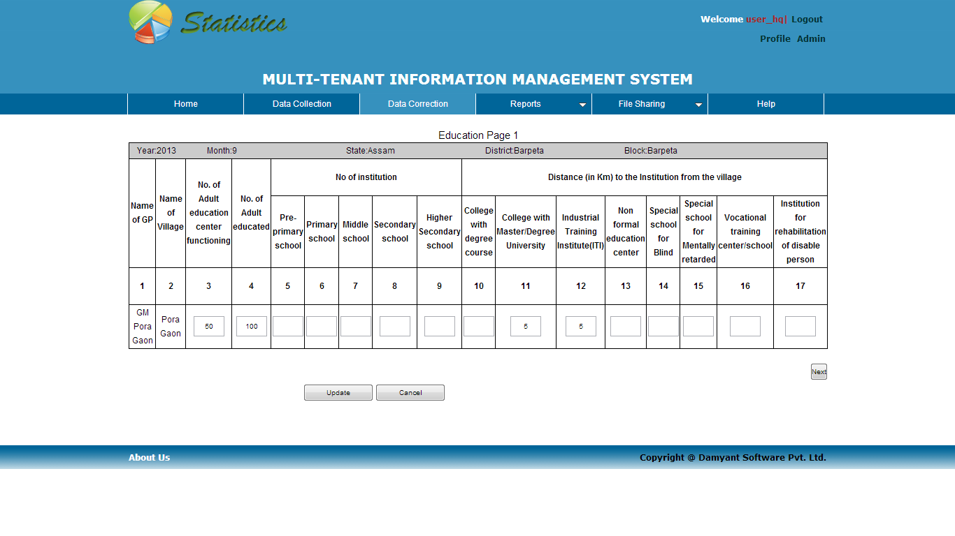
How to use MIMS Cont…
  How to update data in Data Correction Page ?
    For updating/correcting data from 'Data Correction' page you have to select the required fields and click on ‘Submit This Info’ button.
    If there is no data available according to your input then you will get a message ”No Data available”.
    If there is data available according to your inputs then a page opens where you can update the pervious stored data as you can see in below Figure.

Slide 17
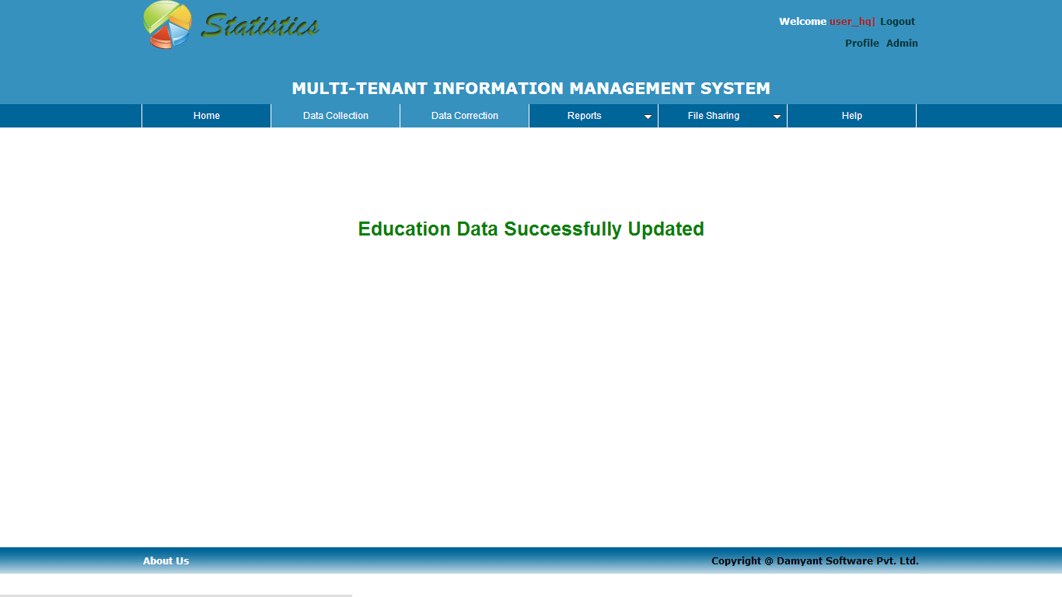
How to use MIMS Cont…
  Now you can update/correct the data by clicking on the box to change the current value.
  After all the changes are done you can click on update button to save the current changes done by you.
  If you don't want to save the changes you have done, you can cancel it by pressing Cancel button and if you save the changes new page open's up as you can see in below Figure

Slide 18
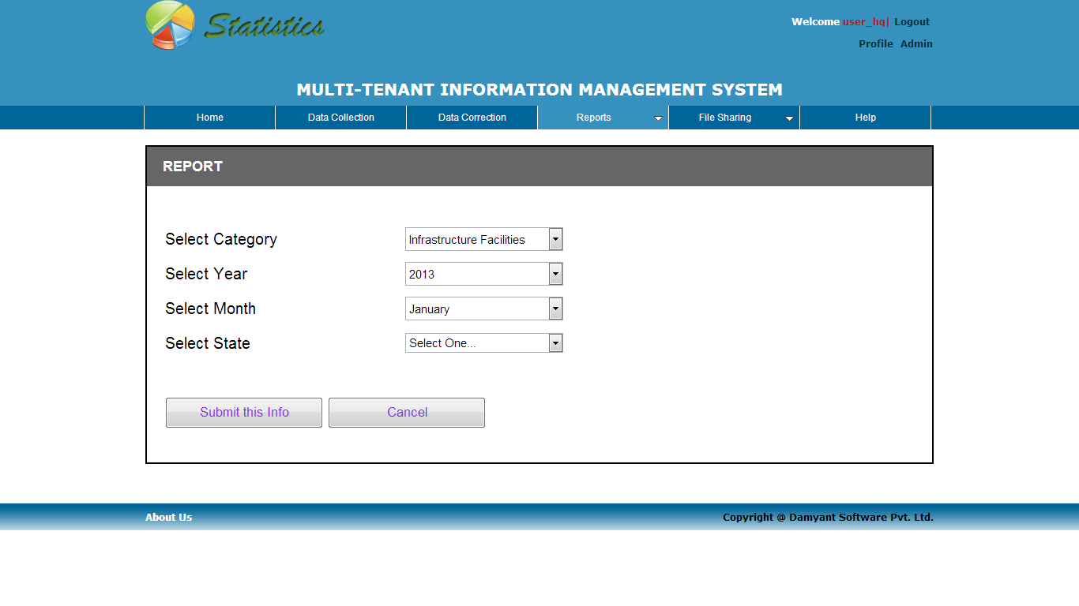
How to use MIMS Cont…
Reports : All users can access the Reports by clicking on the Reports menu link located on the main menu bar. It will open the Report page as you can see in the below Figure.

Slide 19
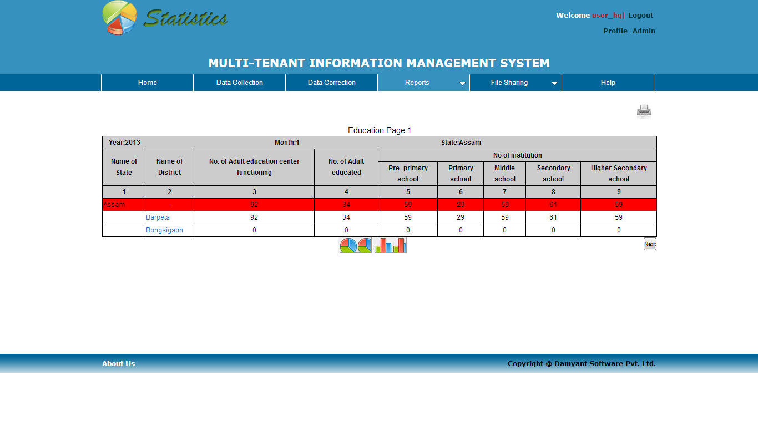
How to use MIMS Cont…
    Select the Category, year, month and state name of which you want to see the report and click on ‘Submit This Info’ and you will see the following page with data based on your selection.
    If you want to see block level data then click on District name which will navigate to the blocks.
    Also you can see the report in graphical representation by clicking on the pie charts and bar chart icons.

Slide 20
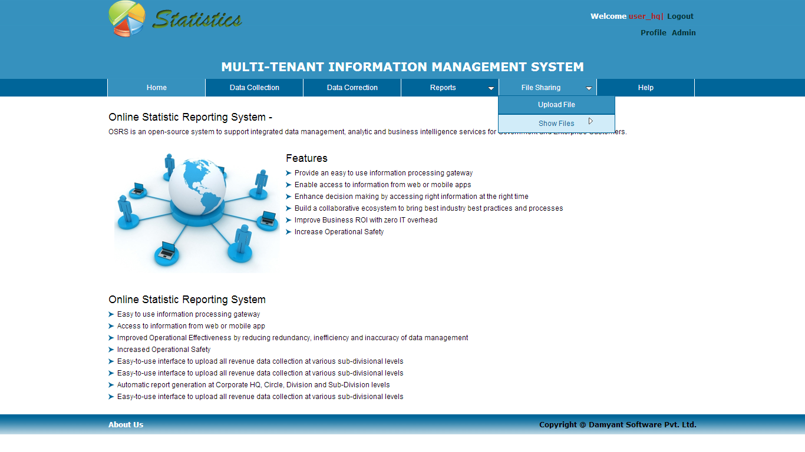
How to use MIMS Cont…
File Sharing : The File Sharing link allows Authenticated User to Upload any type of file at the server. The Authenticated User can view, update and even delete the files from the server. You can upload and view files by clicking on the File Sharing menu link located on the main menu bar. It will give you the two sub-menus as you can see in below Figure.
    There is two sub-menu in ‘File Sharing’ menu, ‘Upload File’ and ‘Show Files’. If you will select upload file then the following page will displayed.

Slide 21
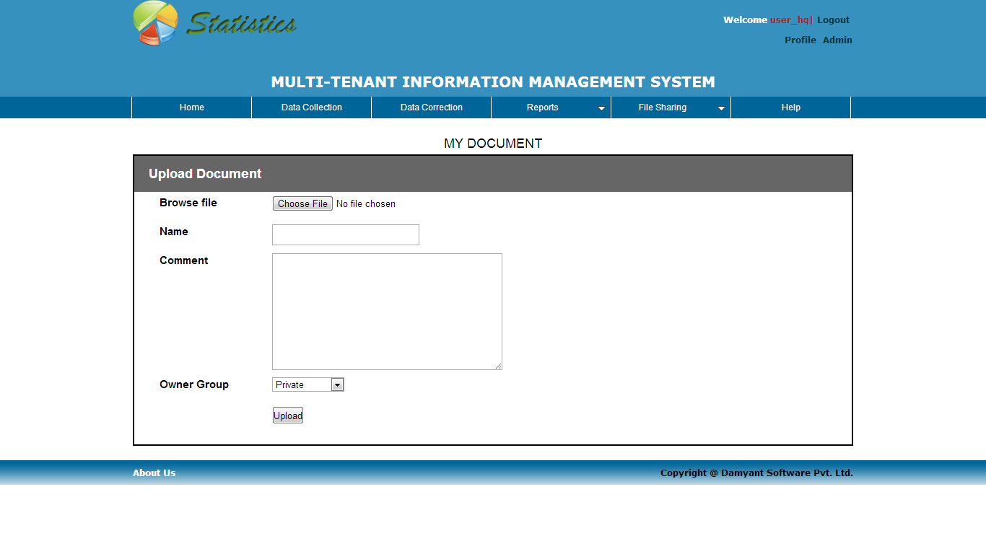
How to use MIMS Cont…
  Browse the file from the system and fill the ‘Name’, ‘Comment’ fields and select group to view the file and by clicking on upload button file will be uploaded.
  If you will select the ‘Show Files’ menu, the list of existing file will be displayed as in the following figure.

Slide 22
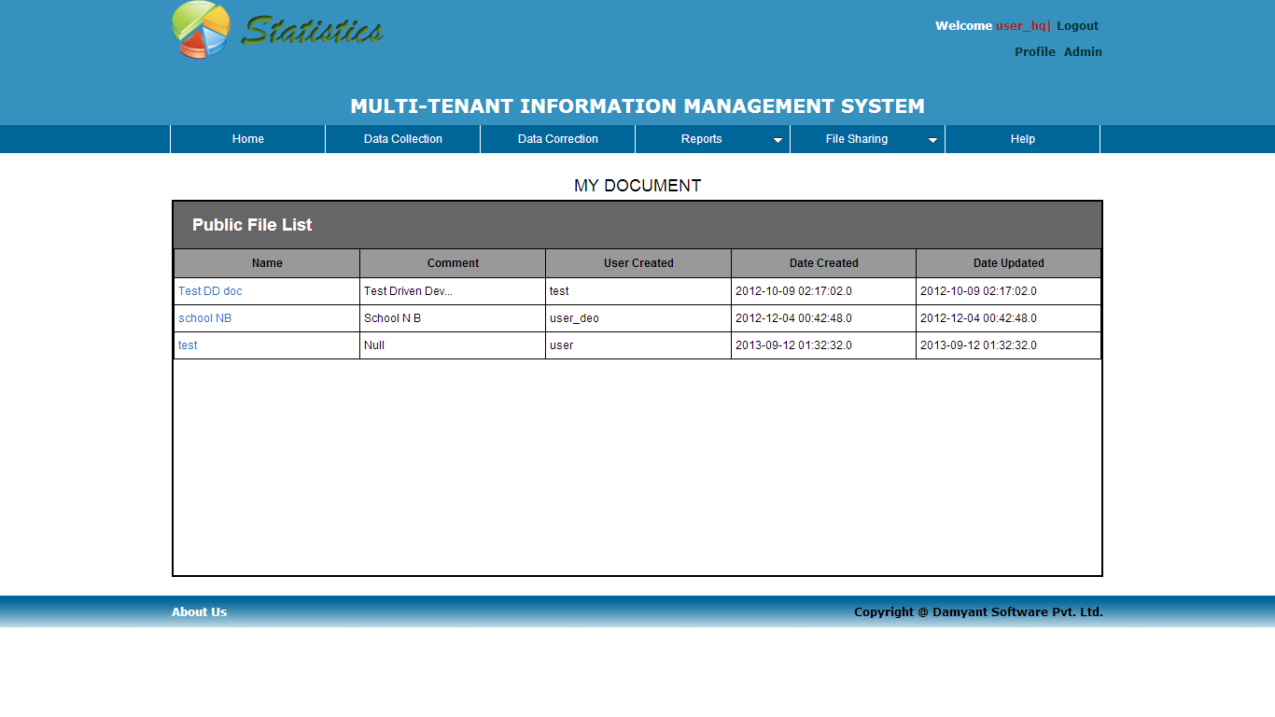
How to use MIMS Cont…

Slide 23
How to use MIMS Cont…
Admin Panel : The Admin Panel will be used by the authenticated users to which the Super-Admin has given the admin rights. It is only visible to the user's who has the role of admin for other user's it's not visible. You can view the 'Admin' link at the top-right of the page as you can see in Figure.
Click here to visit admin panel page

Slide 24
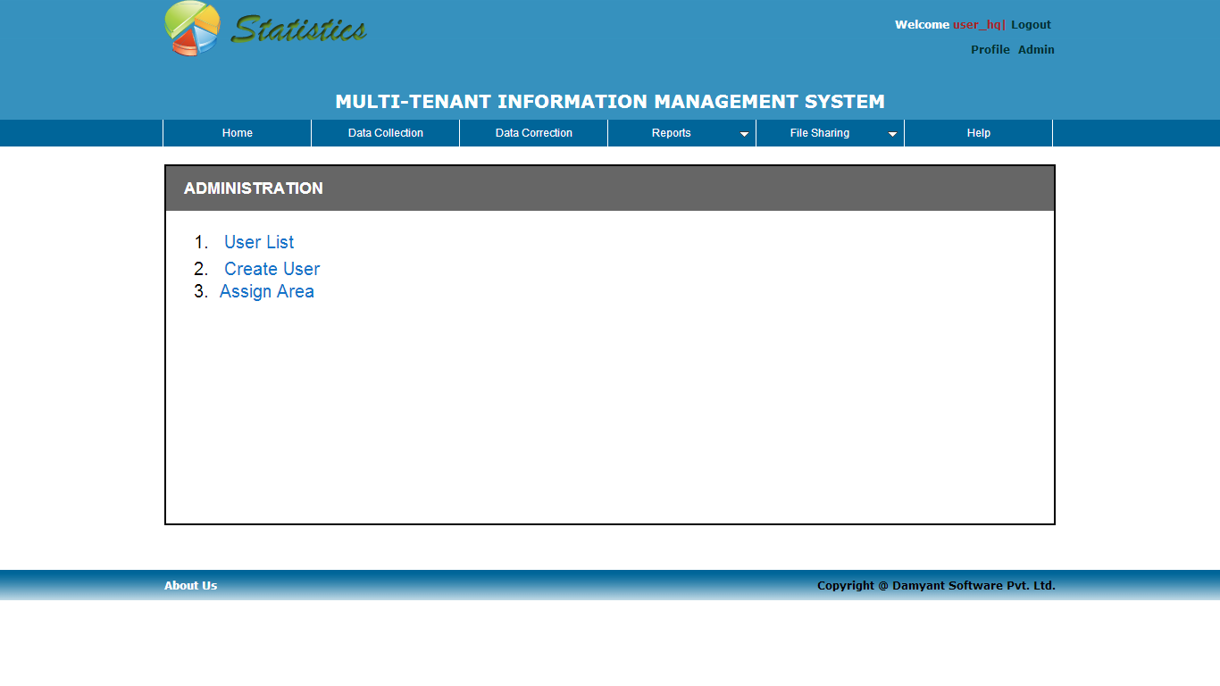
How to use MIMS Cont…
  By clicking on Admin link you can visit 'Admin' page from where you can do administrative related work. In admin page a user who has administrative rights can do the following things as described below and you can see in Figure
    User List
    Create User
    Assign Area

Slide 25
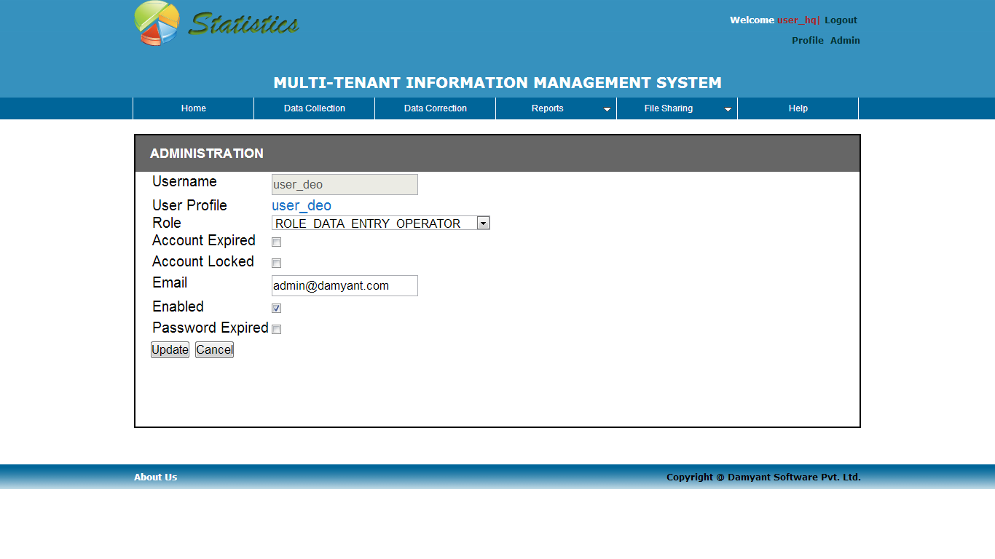
How to use MIMS Cont…
  By clicking on ‘User List’ link you will see the list of all existing users.
  By clicking on ‘Create User’ link you will see the following page from where you can create new users.

Slide 26
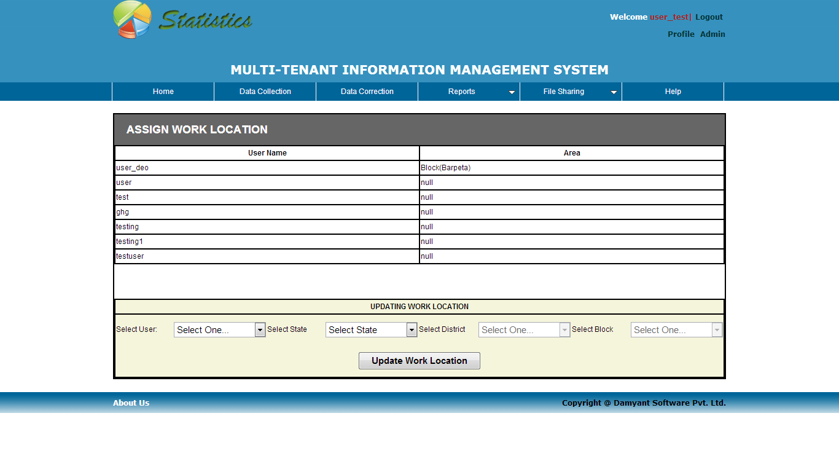
How to use MIMS Cont…
  By clicking on ‘Assign Area’ you will see the following page where you can assign a work area to particular users.

Slide 27
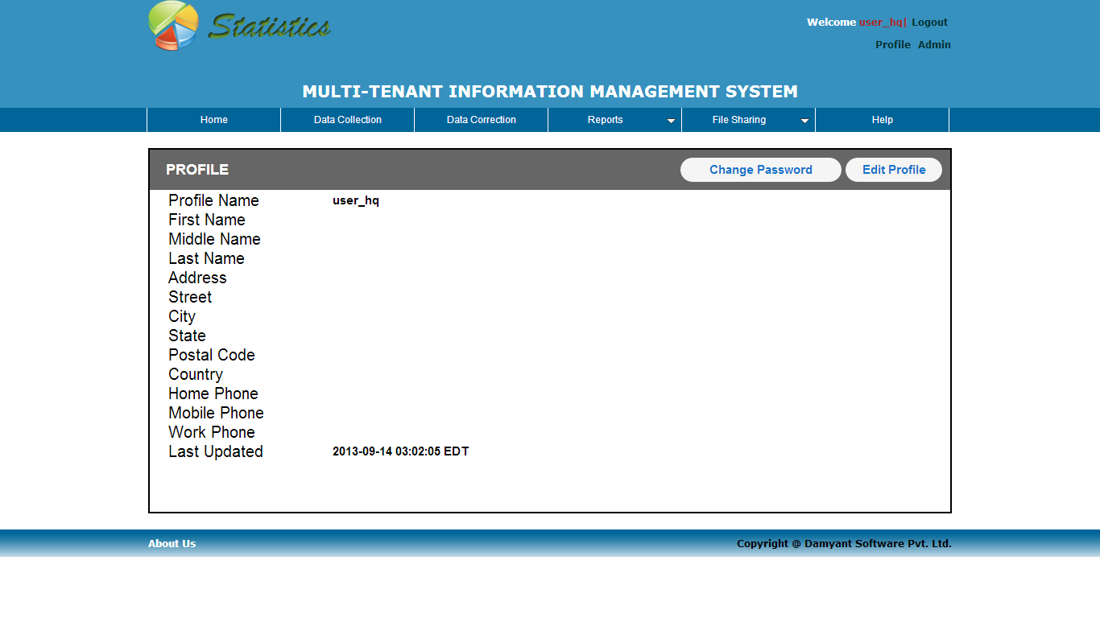
How to use MIMS Cont…
Profile : By clicking on Profile you can see the detailed of your own profile where you have given two rights, one is change password and edit your profile information's.

Slide 28
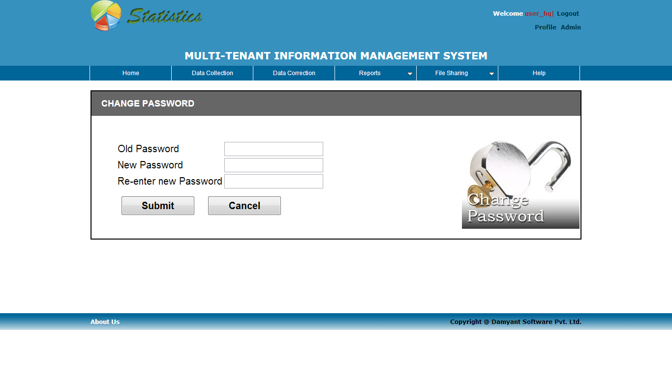
How to use MIMS Cont…
  By clicking on ‘Change Password’ you will see the following page where you can change your password.

Slide 29
Thank You

